Slide 1
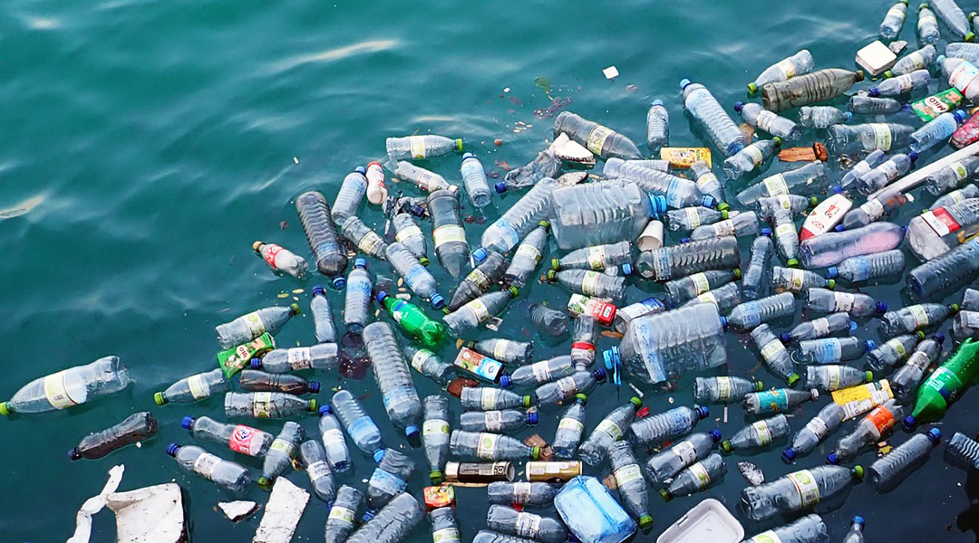
Sustainable Solutions: Reducing Plastic Waste in Retail
8 million metric tons of plastic enter the oceans each year, causing harm to ecosystems and wildlife.
Plastic bags and packaging contribute significantly to plastic waste, with the average American using 1,500 plastic bags per year, and only 1% of plastic bags being recycled.

